Slide 1
Machine learning
Regent College London
SWE6204

Slide 2
Machine learning
SWE6204

Slide 3

Machine learning
SUPPORT VECTOR MACHINE
(SVM)

Slide 4
Module 1 – Support vector machine (svm)

Slide 5
Learning objectives
Understand the concept of SVM
Application of SVM

Slide 6
svm
Works well for classifying higher-dimensional data (lots of features)
Finds higher-dimensional support vectors across which to divide the data (mathematically, these support vectors define hyperplanes. Needless to say I’m not going to get into the mathematical details!)
Uses something called the kernel trick to represent data in higher- dimensional spaces to find hyperplanes that might not be apparent in lower dimensions

Slide 7
hyperplanes
The important point is that SVM’s employ some advanced mathematical trickery to cluster data, and it can handle data sets with lots of features.
It’s also fairly expensive – the “kernel trick” is the only thing that makes it possible

Slide 8
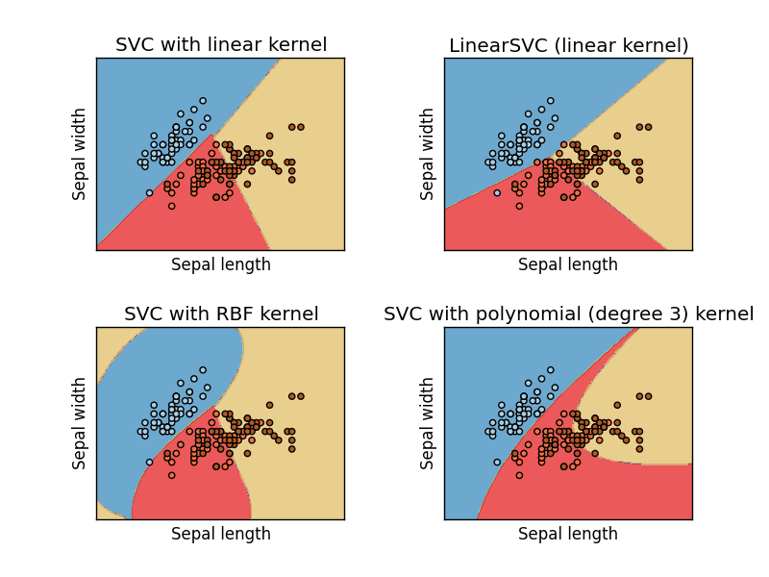
Support vector classification (SVC)
In practice you’ll use something called SVC to classify data using SVM.
You can use different “kernels” with SVC. Some will work better than others for a given data set.

Slide 9
Python coding
Let’s play with SVC’s
• Don’t even try to do this without scikit-learn.

Slide 10
SVM coding video
Watch the video and try to code this in your Python environment
https://www.youtube.com/watch?v=TtKF996oEl8

Slide 11
+44 (0)207 016 8000
info@rcl.ac.uk

